Slide 1
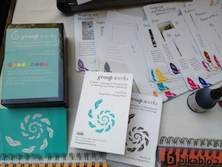
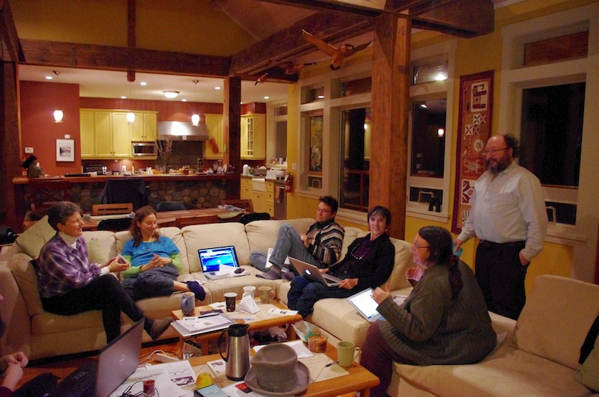
GROUP WORKS: A context-rich, dynamic, interactive learning tool for business leaders and facilitators
A 91-card deck of exemplary group processes and practices, with accompanying booklet and fold-out key
Image by Susan Stewart
Over the past 3 years, more than two dozen experienced facilitation practitioners from many different domains of practice have worked to identify the "patterns" ("things that work" in deliberative group activities in many different contexts and at different scales), patterns that characterize highly-effective meetings, conferences, problem-solving and decision-making gatherings. This deck is the result.
Your key to more effective business meetings and conferences through better design, better facilitation and better participant engagement.
The deck can be used for:
Self-learning: improving your own facilitation and meeting design processes and practices
Event preparation, and post-event reflection: enabling teams to design and organize better meetings, and to debrief on how processes and practices could be further improved
Teaching: as a tool for developing leadership and facilitation skills in new staff and managers, and as an analysis tool in case study work

Slide 2
Key to the Cards
Each card is laid out as follows:
Intention
Context
Relationship
Flow
Creativity
Perspective
Modelling
Inquiry & Synthesis
Faith
What some users have said about the deck:
Order the deck now: $25 for 91-card 3.5” x 5.5” deck with explanatory fold-out key and booklet; $20 per deck for orders of 10 decks or more.
For orders, free PDF downloads and more information please visit our website:
http://groupworksdeck.org
or call Dave Pollard at +1 (604) 947-2758
"Now, more than ever, we need communities and organizations that function creatively and well. Group Works is a terrific contribution to making that happen. The beautiful cards make visible underlying dynamics of great interactions. And as a bonus, it's fun to use!" - Peggy Holman, author, 'Engaging Emergence: Turning Upheaval into Opportunity' and co-author, 'The Change Handbook'
"These beautiful cards mark a watershed in the evolving power of conversations, quality personal interactions, and vibrant gatherings and communities… I can't recommend Group Works cards highly enough." - Tom Atlee, founder of the Co-Intellgence Institute, author of 'The Tao of Democracy' and 'Reflections on Evolutionary Activism'

